Slide 1


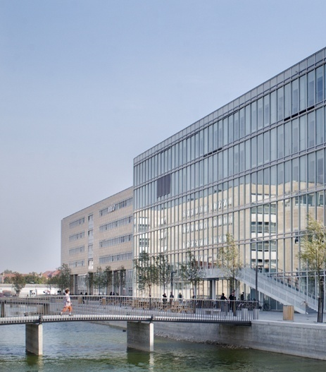
OPEN MEDIA SCIENCE
(In press, Journal of Science Communication)
Center for Subjectivity Research
Kristian Moltke Martiny
The Elsass Institute & Center for Subjectivity Research,
University of Copenhagen
David Budtz Pedersen
Aalborg University Copenhagen
&
Alfred Birkegaard
Roskilde University

Slide 2
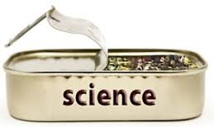
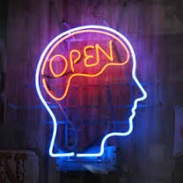
Open Science: What?
Center for Subjectivity Research
“Opening up the research process as early as is practically possible” (Nielsen 2011)
Dimensions
Open Methodology
Open Source
Open Data
Open Peer Review
Open Access
Open Educational Resources
(Watson 2015; OpenScience ASAP; Kraker et al. 2011)

Slide 3
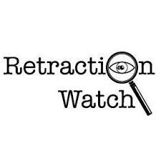
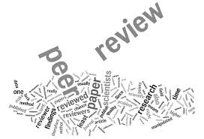
Open Science: Why?
Center for Subjectivity Research
Negative argument
The economic landscape of publications, promotion and reputation exaggerates and inflates scientific knowledge (Young et al., 2008, Budtz Pedersen & Hendricks 2014)
Publication retractions have shot up tenfold in the past decade (van Noorden 2011)
Exponential growth of publications creates an overload of information (Price 1963)
Peer review is slow, non-transparent and inefficient (Smith 2010)
Large parts of literature and data go unnoticed and are under-used (Meho 2007)
The “reproducibility crisis” reflects a lack of openness about methodological information and datasets (Knorr-Cetina 1981)

Slide 4
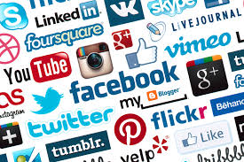
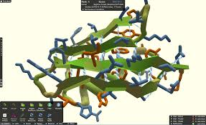
Open Science: How?
Center for Subjectivity Research
Online and socio-technical tools have reinvented the way in which researchers create knowledge (Nielsen 2012):
“A fourth age of research” driven by international collaborations between research teams and large-scale digital interaction (Adams 2013).
New forms of databases, tools and citation methods improve knowledge acquisition and dissemination (Meho 2007).
Improvement of the contribution to problem-solving and impact-oriented solutions in society (Science 2.0, Moedas 2015).
Examples: Open repository (ArXive), Open Database (SPIRES, GenBank), Citizen Science (Foldit, the Polymath Project, Galaxy Zoo) and Crowdsourcing (InnoCentive).
Question: how ‘open’ is open science today (Wiggins & Crowston 2011)?

Slide 5

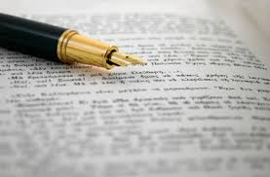
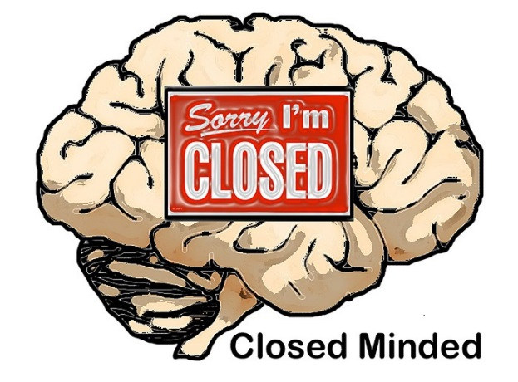
Open Science ≠ Open Access (text-format)
Center for Subjectivity Research
Communication
Hyper-specialization: Open Access (OA) preserves a conservative approach to the dissemination of science, specializing methodologies, technologies, data, and theories and communicating through journal publications.
Familiarity: specialized terminologies, methods, tools and data are taken for granted and is comprehensible to only a small minority of specialists.
Collaboration
Limited collaboration: OA is limited to journal publication (collaboration = co-authorship), overlooking the collaborative possibilities that new online tools and social media offer.
Exclusion: Journal publications cause a ‘hyper-specialization’ that excludes scholars and citizens from many aspects of the scientific process (Ito 2014).

Slide 6


A ‘Second Wave’ Open Science
Center for Subjectivity Research
Wave: primarily driven by openness in publications and using the text-format.
Wave: Includes new communication platforms and engagement technologies that extend beyond mere scientific scholarship and data understood as what can be captured in a text.
Open Media
Practicing open science with other media and data-formats than publications, emphasizing the ambition of opening up the media through which scientific knowledge is processed, validated and circulated.
A supplement to conventional publication and communication platforms (Bourne 2010)

Slide 7
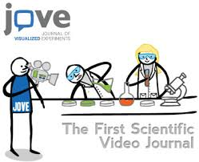
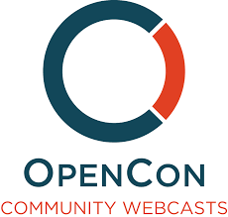
Open Media Examples
Center for Subjectivity Research
FoldIt: using virtual interaction and gamification as a way to cultivate large-scale research collaboration and mass experimentation (Copper et al. 2010).
Journal of Visualized Experiments (JOVE): scientists upload videos of how their experiments work.
Nature: producing audiovisual summaries of (selected) research papers (Inchcoombe & Newton 2015).
PLOS: focuses on audiovisual communication by introducing an OpenCon Community Webcast.

Slide 8

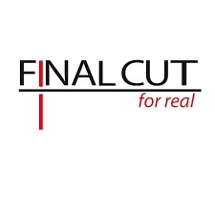

COLLABORATION BETWEEN SCIENCE AND DOCUMENTARY
Center for Subjectivity Research
Pilot-project
Workshop with The Danish Film Institute, Creative Europe Media Desk, and Final Cut 4 Real:
50 researchers and 50 documentarists and producers.
There are more parallels and similarities than differences between scientists and documentary filmmakers work.
Scientists are open to include documentary films in their research process.
Is it possible to use documentary films in real-time as part of one’s research methodology and explorative process?
(ScienceXCinema Interviews: https://www.youtube.com/watch?v=HTdGduh_6mM)

Slide 9
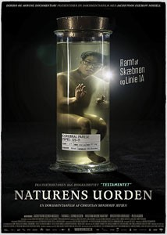
1. Experiment: Natural Disorder (dir. Christian Sønderby Jepsen)
Center for Subjectivity Research
Plot: About Jacob Nossell, who lives with cerebral palsy (CP), and understanding what it means to live with CP.
Premiere: Danish Cinemas October 2015, internationally IDFA November 2015. See: Vimeo.
Results
A ‘Bio-psycho-social’ model of living with CP becomes a large scale collaboration
Collaboration requires a Joint Problem Space (JPS), external medium (Roschelle and Teasley 1995)
Written medium cannot be a JPS, but audio-visual medium can (Roschelle 1998):
  Open ‘bodily, situated and enacted’ data (thick data)
  Multidisciplinary and participatory analysis
  Public engagement and empowering narrative

Slide 10
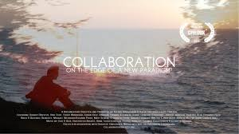
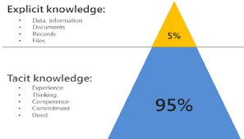
2. Eksperiment: Collaboration (dir. Alfred Birkegaard)
Center for Subjectivity Research
Plot: investigating the impact of the Internet and online collaboration on the scientific community by interviewing the world’s most prominent researchers in the field.
Premiere: CPH:DOX. October 2014 and Danish national television May 2015. Open Access.
  Results
  What is scientific collaboration?
  Uses audio-visual medium to conduct fieldwork, interviews, journals and observations, engaging with one’s research topic in a contextualized way (Roschelle 1998).
  Opening up the workflow (Bourne 2010) through recording interviews, feedback-looping the process by showing the scientists their own interviews.
  Using other media and data than textual is taking the tacit (‘know how’) dimension of knowledge serious, since then communication becomes immediate and transparent.

Slide 11
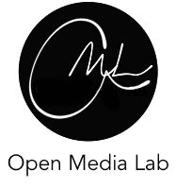

The Challenge of Cultivation
Center for Subjectivity Research
“Research video is not like a research paper because a research video lacks a commonly understood genre” (Roschelle 1998).
Evaluation and validation of Open Media Science?
Data: ‘first-person’, ‘phenomenal’, ‘deep and thick’ data is open, dynamic, transparent and something that is embodied, enacted and generated in the world together with other subjects.
A socially performative and pragmatic process, “intersubjective validation” (Varela & Shear 1999)
Open-ended: 1) open peer review, 2) open data, and 3) dynamic evaluation of data, with a broader public of creative and curious individuals.
Collaboratorium: Experiment in Progress
Open Media Lab at Roskilde University
Collaboration with the America app company Storyfriend
Future labs: MIT Media LAb, Harvard, Technical University Denmark, IT University of Copenhagen.

Slide 12
Center for Subjectivity Research
Thanks for listening

